Slide 1
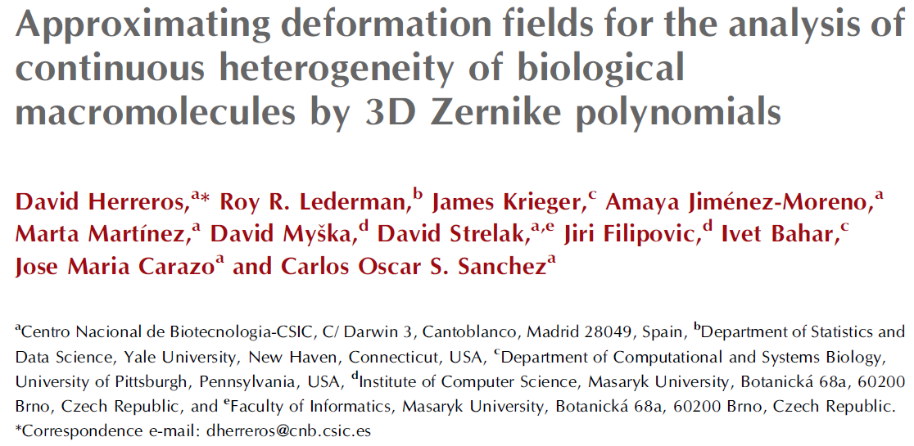
林思涵
2023/03/28
2022/06/28

Slide 2
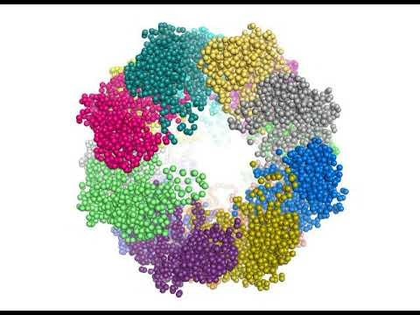
30 different models along an open–closed transition of the mammalian chaperonin CCT complex between two atomic models derived from a previous cryo-EM study

Slide 3
Q: 如果已有30個structure maps (3D conformations) 要如何知道他們之間的動態過程?
Ans: MDS
(Multidimensional Scaling)

Slide 4
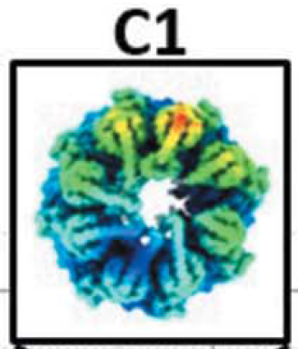
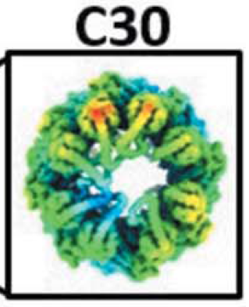
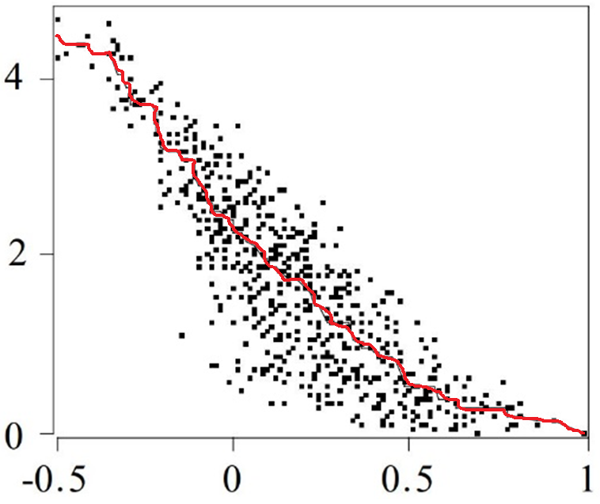
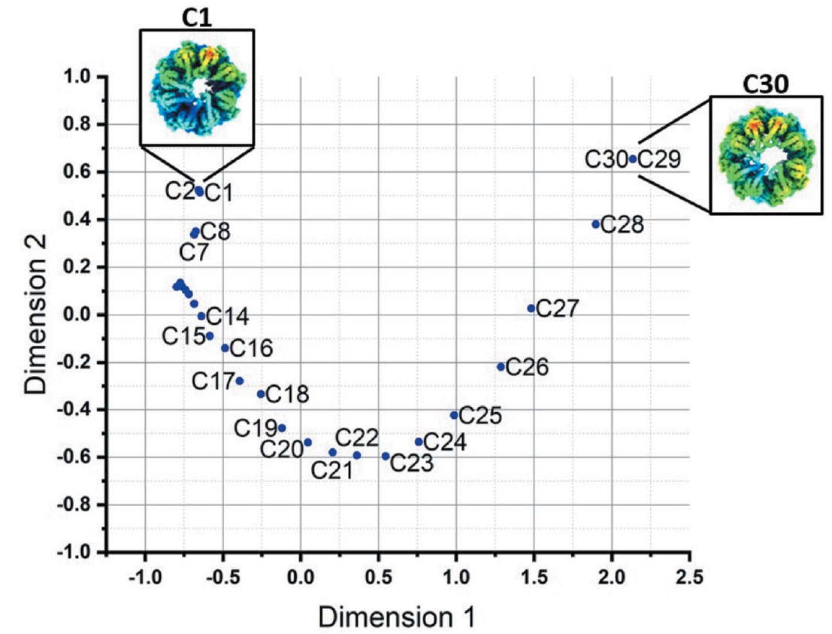
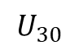
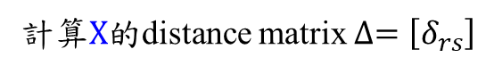
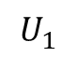
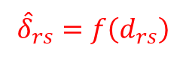
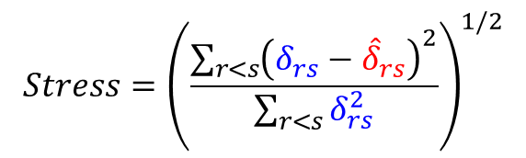
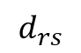
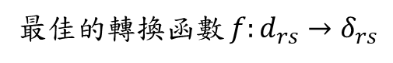
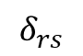
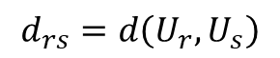
MultiDimensional Scaling
$$U_{1}$$
$$U_{30}$$
$$d_{rs}=d\left(U_{r},U_{s}\right)$$
……
計算 3D conformations 的的similarity matrix $D=\left[d_{rs}\right]$
$${\hat{δ}}_{rs}=f\left(d_{rs}\right)$$
$$δ_{rs}$$
最佳的轉換函數 $f:d_{rs}→δ_{rs}$
$$d_{rs}$$
計算$X$的distance matrix $∆=\left[δ_{rs}\right]$
$$Stress={\left(\frac{\sum_{r<s}{{\left(δ_{rs}−{\hat{δ}}_{rs}\right)}^{2}}}{\sum_{r<s}{δ_{rs}^{2}}}\right)}^{1/2}$$
(初始值可用PCA)

Slide 5
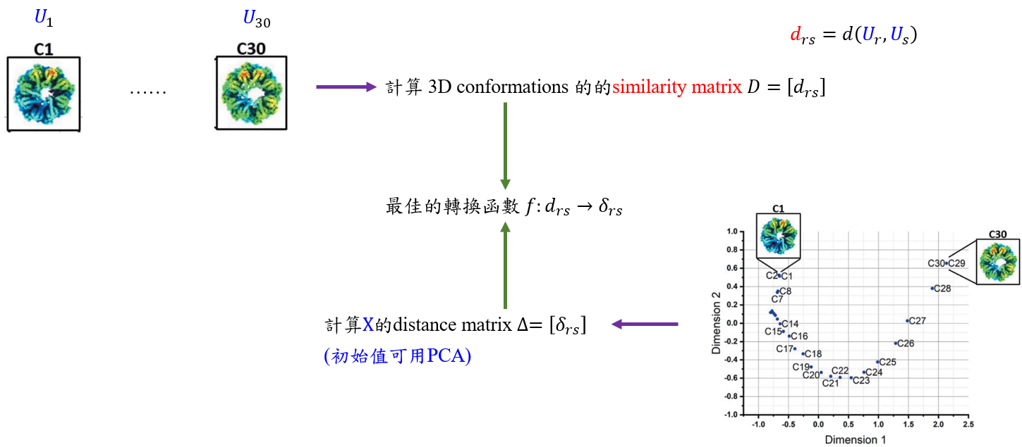
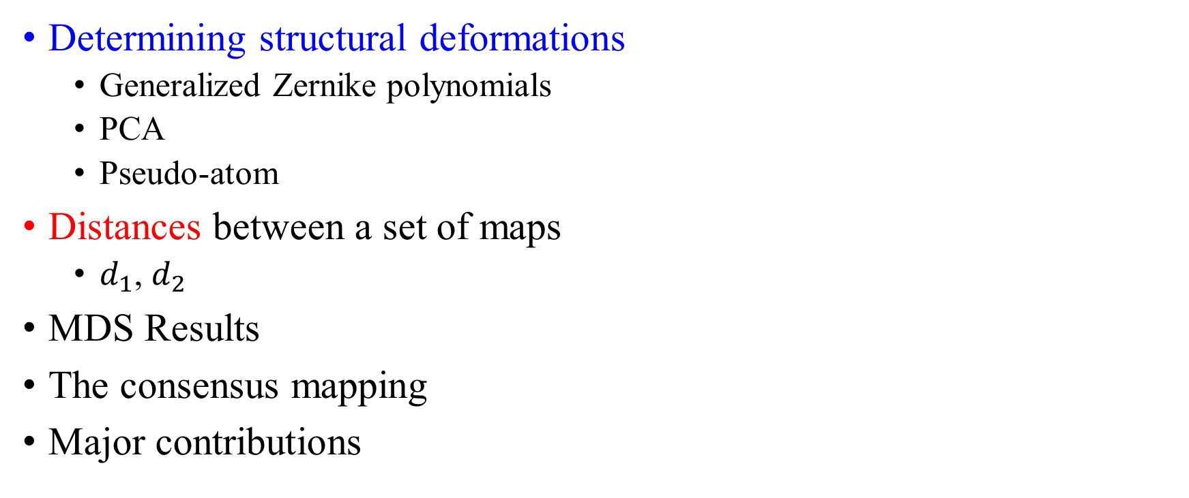
Outline
Determining structural deformations
Generalized Zernike polynomials
PCA
Pseudo-atom
Distances between a set of maps
$d_{1}$, $d_{2}$
MDS Results
The consensus mapping
Major contributions

Slide 6
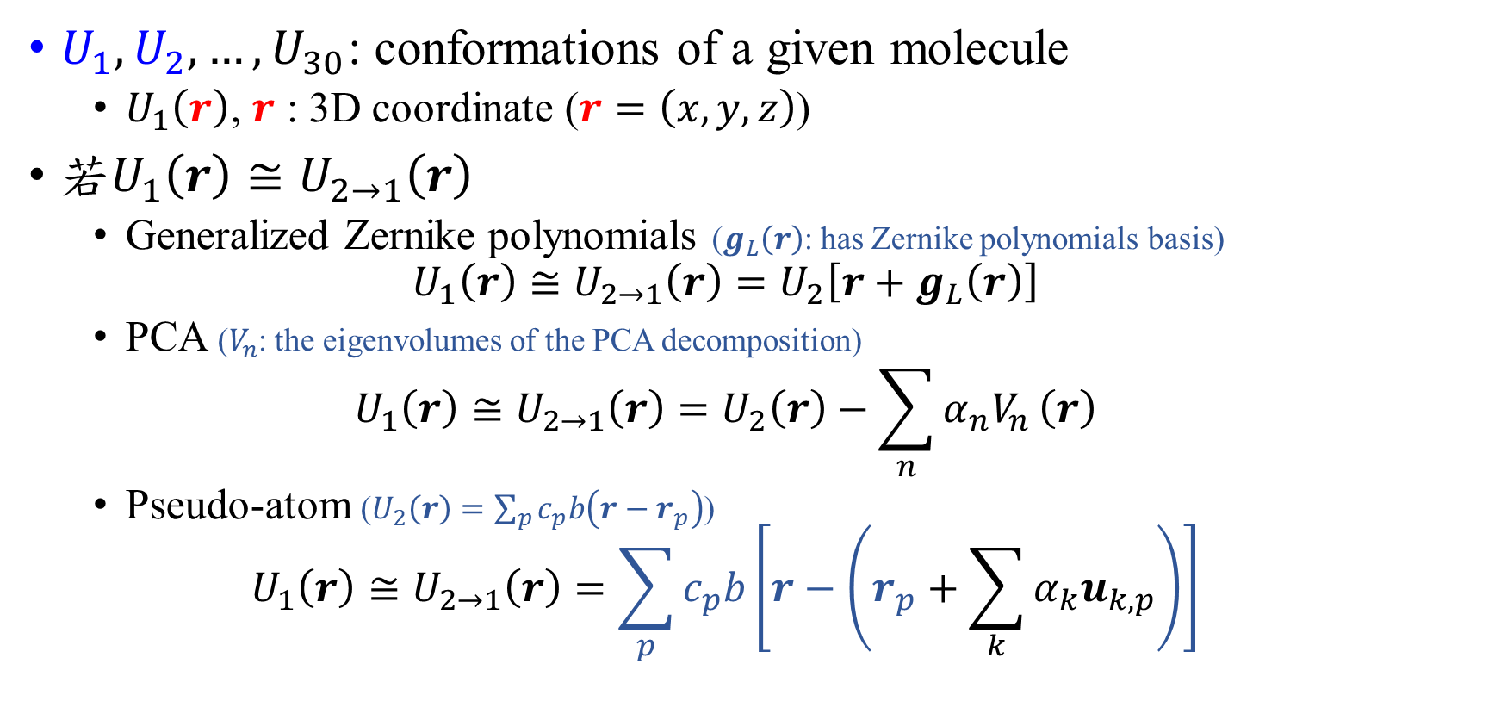
Determining structural deformations Notations
$U_{1}, U_{2}, …, U_{30}$: conformations of a given molecule
$U_{1}\left(r\right)$, $r$ : 3D coordinate ($r=\left(x,y,z\right)$)
若$U_{1}\left(r\right)≅U_{2→1}\left(r\right)$
Generalized Zernike polynomials ($g_{L}\left(r\right)$: has Zernike polynomials basis)
$$U_{1}\left(r\right)≅U_{2→1}\left(r\right)=U_{2}\left[r+g_{L}\left(r\right)\right]$$
PCA ($V_{n}$: the eigenvolumes of the PCA decomposition)
$$U_{1}\left(r\right)≅U_{2→1}\left(r\right)=U_{2}\left(r\right)−\sum_{n}{α_{n}V_{n}}\left(r\right)$$
Pseudo-atom ($U_{2}\left(r\right)=\sum_{p}{c_{p}b\left(r−r_{p}\right)}$)
$$U_{1}\left(r\right)≅U_{2→1}\left(r\right)=\sum_{p}{c_{p}b\left[r−\left(r_{p}+\sum_{k}{α_{k}u_{k,p}}\right)\right]}$$

Slide 7
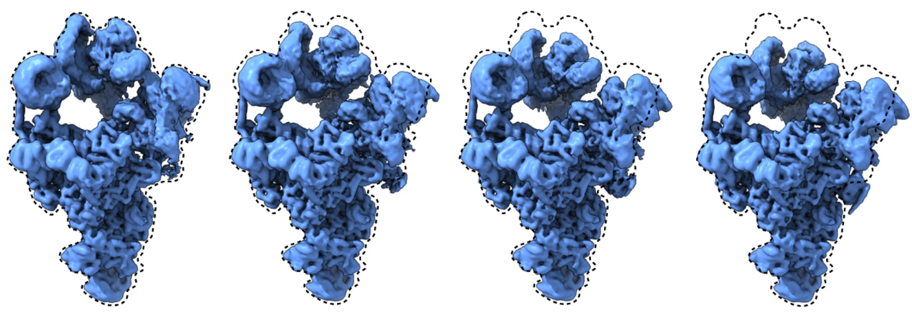
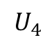
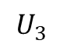
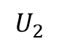
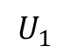
Generalized Zernike polynomials
$$U_{1}$$
$$U_{2}$$
$$U_{3}$$
$$U_{4}$$

Slide 8
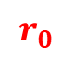
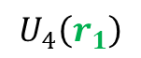
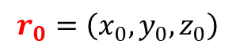
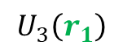
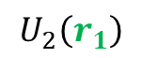
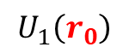
Generalized Zernike polynomials
$$U_{1}\left(r_{0}\right)$$
$$U_{2}\left(r_{1}\right)$$
$$U_{3}\left(r_{1}\right)$$
$$U_{4}\left(r_{1}\right)$$
.
.
.
$$r_{0}$$
.
$$r_{0}=\left(x_{0},y_{0},z_{0}\right)$$
$$U_{1}\left(r_{0}\right)≅U_{i→1}\left(r_{0}\right)=U_{2}\left[r_{0}+g_{L}\left(r_{0}\right)\right]=U_{i}\left(r_{1}\right)$$

Slide 9
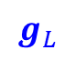
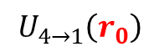

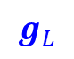
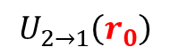
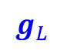
Generalized Zernike polynomials
$$U_{1}\left(r_{0}\right)$$
$$U_{2}\left(r_{1}\right)$$
$$U_{3}\left(r_{1}\right)$$
$$U_{4}\left(r_{1}\right)$$
.
.
.
.
.
.
$$r_{0}$$
.
$$g_{L}$$
$$g_{L}$$
$$g_{L}$$
$$U_{2→1}\left(r_{0}\right)$$
$$U_{3→1}\left(r_{0}\right)$$
$$U_{4→1}\left(r_{0}\right)$$
$$r_{0}=\left(x_{0},y_{0},z_{0}\right)$$
$$U_{1}\left(r_{0}\right)≅U_{i→1}\left(r_{0}\right)=U_{2}\left[r_{0}+g_{L}\left(r_{0}\right)\right]=U_{i}\left(r_{1}\right)$$

Slide 10
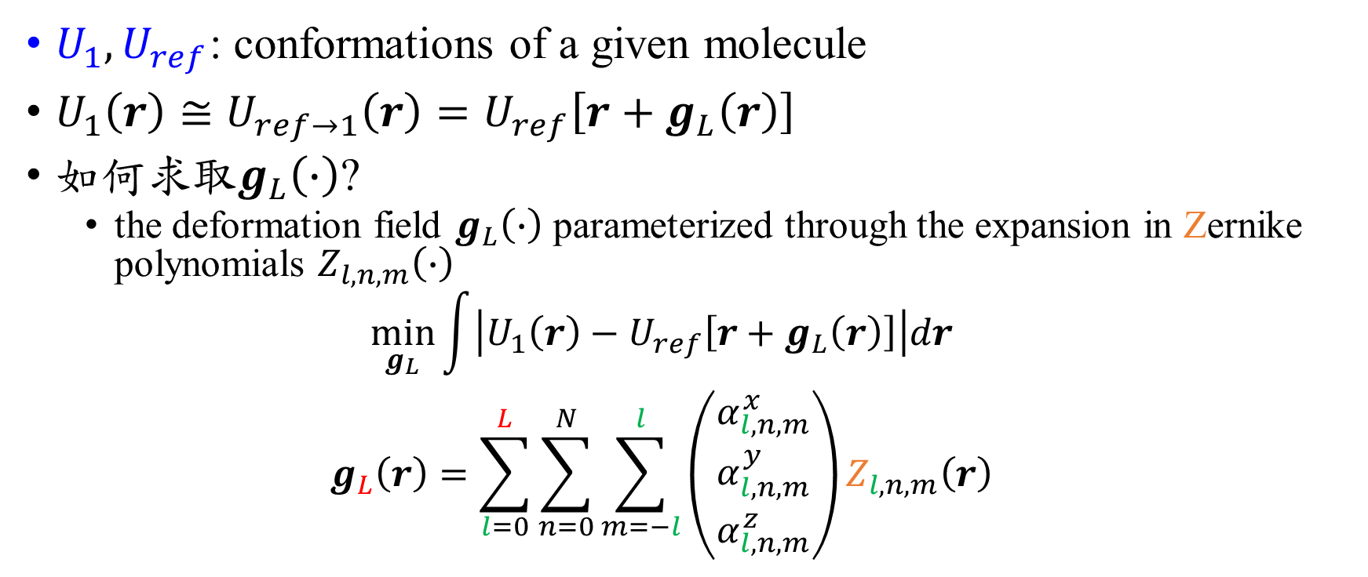
Generalized Zernike polynomials
$U_{1}, U_{ref}$: conformations of a given molecule
$U_{1}\left(r\right)≅U_{ref→1}\left(r\right)=U_{ref}\left[r+g_{L}\left(r\right)\right]$
如何求取$g_{L}\left(∙\right)$?
the deformation field $g_{L}\left(∙\right)$ parameterized through the expansion in Zernike polynomials $Z_{l,n,m}\left(∙\right)$
$$\min_{g_{L}}{\int{\left|U_{1}\left(r\right)−U_{ref}\left[r+g_{L}\left(r\right)\right]\right|dr}}$$
$$g_{L}\left(r\right)=\sum_{l=0}^{L}{\sum_{n=0}^{N}{\sum_{m=−l}^{l}{\left(\begin{matrix}α_{l,n,m}^{x} \\ α_{l,n,m}^{y} \\ α_{l,n,m}^{z}\end{matrix}\right)Z_{l,n,m}\left(r\right)}}}$$

Slide 11
3D real-valued generalized Zernike polynomials

Slide 12
2D時， Zernike與Fourier Transform的關係

Slide 13
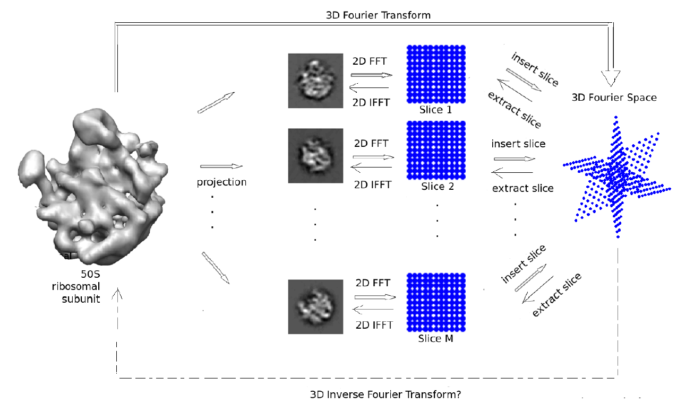
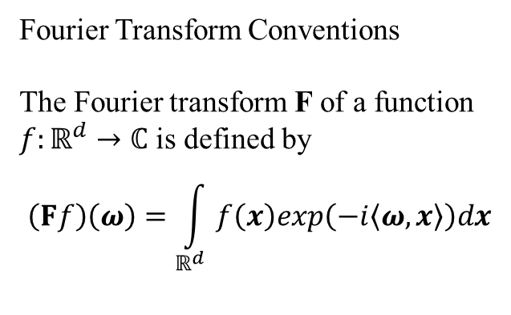
Fourier Transform Conventions
The Fourier transform F of a function
$f:ℝ^{d}→ℂ$ is defined by
$$\left(Ff\right)\left(ω\right)=\int_{ℝ^{d}}{f\left(x\right)exp\left(−i\left\langle ω,x\right\rangle \right)dx}$$

Slide 14
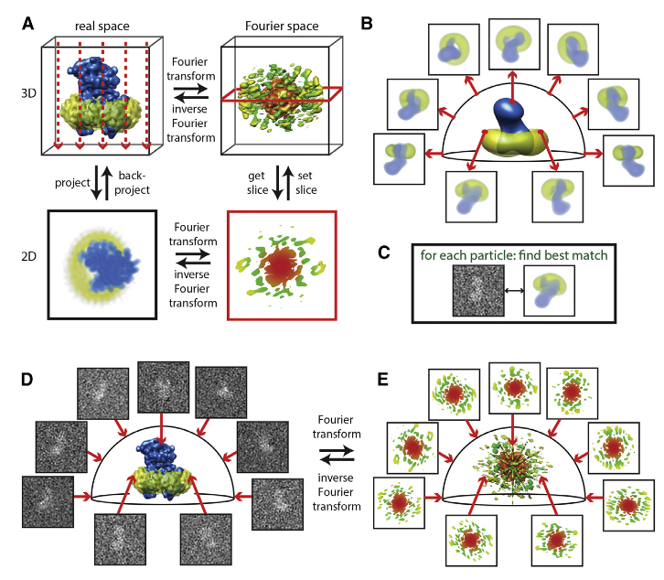
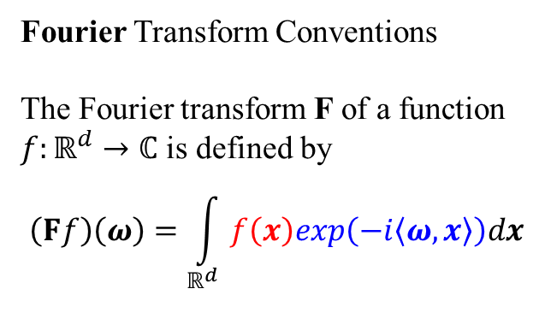
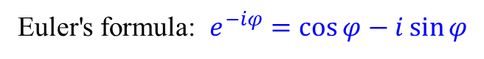
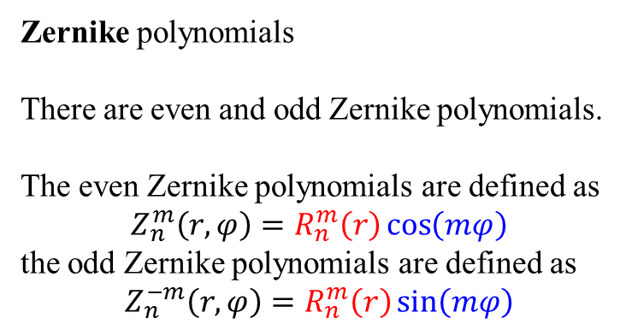
Fourier Transform Conventions
The Fourier transform F of a function
$f:ℝ^{d}→ℂ$ is defined by
$$\left(Ff\right)\left(ω\right)=\int_{ℝ^{d}}{f\left(x\right)exp\left(−i\left\langle ω,x\right\rangle \right)dx}$$
Euler's formula: $e^{−iφ}=\cos{φ}−i\sin{φ}$
Zernike polynomials
There are even and odd Zernike polynomials.
The even Zernike polynomials are defined as
$$Z_{n}^{m}\left(r,φ\right)=R_{n}^{m}\left(r\right)\cos\left(mφ\right)$$
the odd Zernike polynomials are defined as
$$Z_{n}^{−m}\left(r,φ\right)=R_{n}^{m}\left(r\right)\sin\left(mφ\right)$$
Zernike polynomials 與 Fourier Transform 存在某種轉換關係

Slide 15
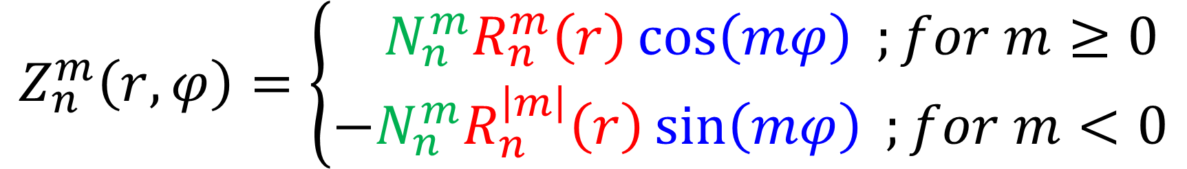
$$Z_{n}^{m}\left(r,φ\right)=\left\{\begin{matrix}−N_{n}^{m}R_{n}^{m}\left(r\right)\cos\left(mφ\right) ;for m≥0 \\ −N_{n}^{m}R_{n}^{\left|m\right|}\left(r\right)\sin\left(mφ\right) ;for m<0\end{matrix}\right.$$
Normalization
Azimuthal Component
Radial Component

Slide 16
此篇用的是3D下的Zernike Generalized Zernike polynomials

Slide 17
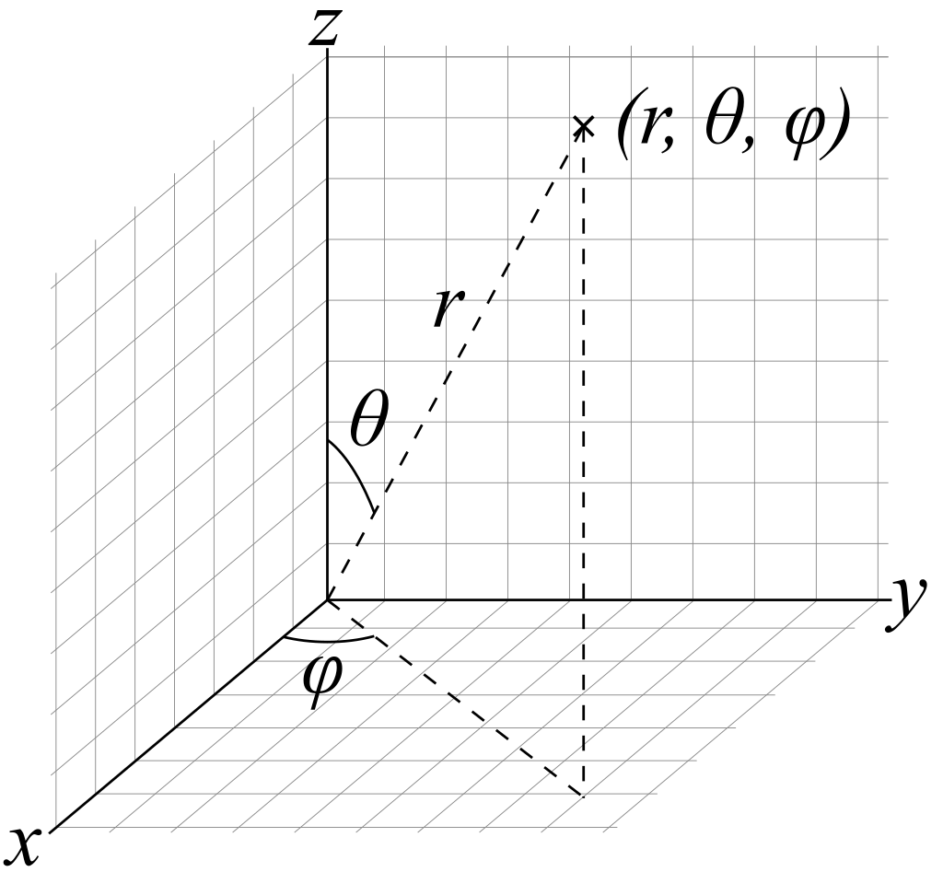
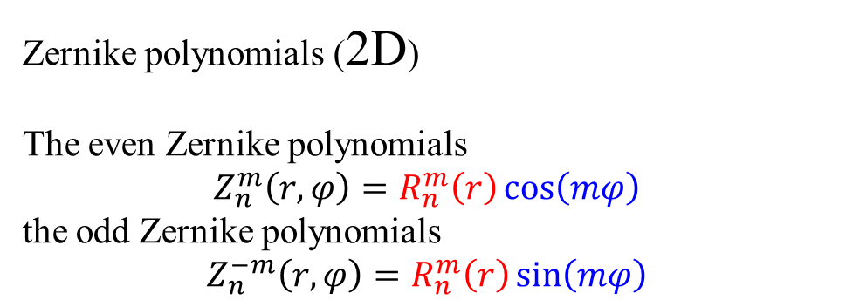
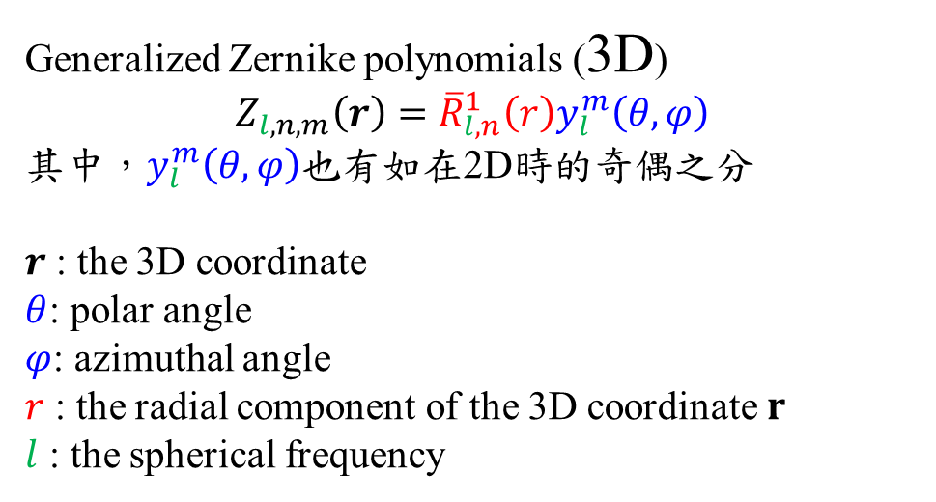
從2D到3D
Zernike polynomials (2D)
The even Zernike polynomials
$$Z_{n}^{m}\left(r,φ\right)=R_{n}^{m}\left(r\right)\cos\left(mφ\right)$$
the odd Zernike polynomials
$$Z_{n}^{−m}\left(r,φ\right)=R_{n}^{m}\left(r\right)\sin\left(mφ\right)$$
Generalized Zernike polynomials (3D)
$$Z_{l,n,m}\left(r\right)={\overline{R}}_{l,n}^{1}\left(r\right)y_{l}^{m}\left(θ,φ\right)$$
其中，$y_{l}^{m}\left(θ,φ\right)$也有如在2D時的奇偶之分
$r$ : the 3D coordinate
$θ$: polar angle
$φ$: azimuthal angle
$r$ : the radial component of the 3D coordinate $r$
$l$ : the spherical frequency

Slide 18
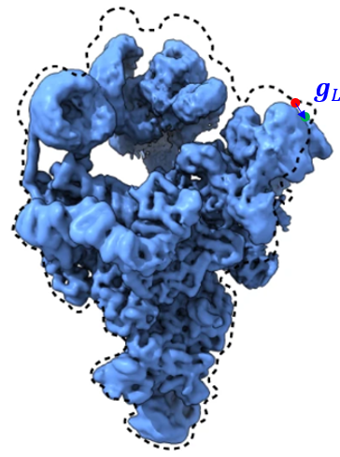
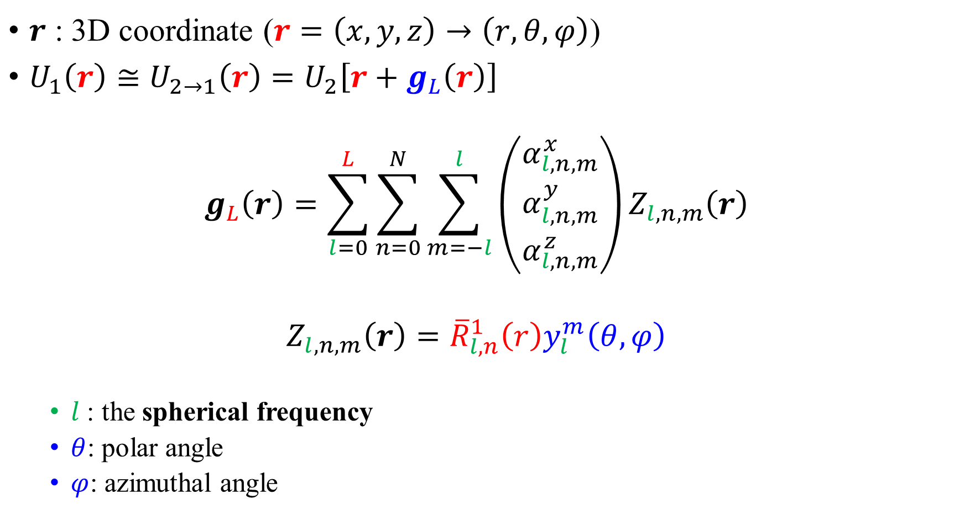
$r$ : 3D coordinate ($r=\left(x,y,z\right)→\left(r,θ,φ\right)$)
$U_{1}\left(r\right)≅U_{2→1}\left(r\right)=U_{2}\left[r+g_{L}\left(r\right)\right]$
$$g_{L}\left(r\right)=\sum_{l=0}^{L}{\sum_{n=0}^{N}{\sum_{m=−l}^{l}{\left(\begin{matrix}α_{l,n,m}^{x} \\ α_{l,n,m}^{y} \\ α_{l,n,m}^{z}\end{matrix}\right)Z_{l,n,m}\left(r\right)}}}$$
$$Z_{l,n,m}\left(r\right)={\overline{R}}_{l,n}^{1}\left(r\right)y_{l}^{m}\left(θ,φ\right)$$
$l$ : the spherical frequency
$θ$: polar angle
$φ$: azimuthal angle

Slide 19
Zernike polynomials (basis)

Slide 20
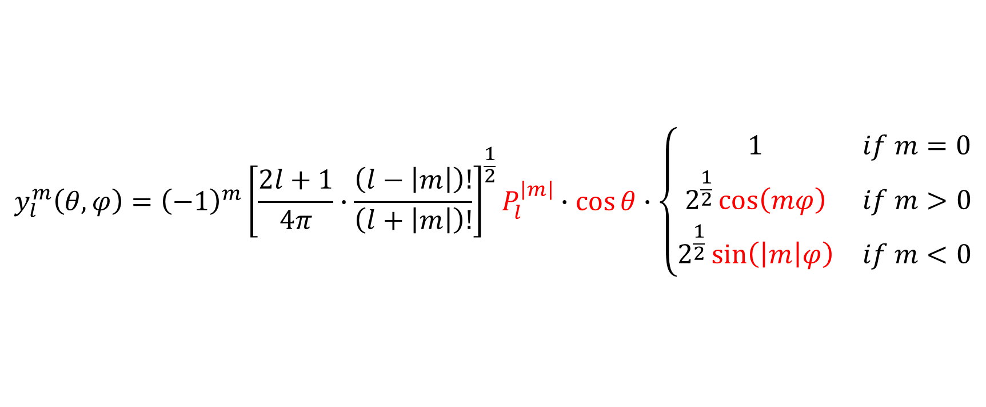

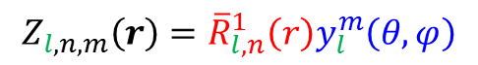
$$y_{l}^{m}\left(θ,φ\right)$$
$$Z_{l,n,m}\left(r\right)={\overline{R}}_{l,n}^{1}\left(r\right)y_{l}^{m}\left(θ,φ\right)$$
$$y_{l}^{m}\left(θ, φ\right)={\left(−1\right)}^{m}{\left[\frac{2l+1}{4π}∙\frac{\left(l−\left|m\right|\right)!}{\left(l+\left|m\right|\right)!}\right]}^{\frac{1}{2}}P_{l}^{\left|m\right|}∙\cos{θ}∙\left\{\begin{matrix}1 & if m=0 \\ 2^{\frac{1}{2}}\cos\left(mφ\right) & if m>0 \\ 2^{\frac{1}{2}}\sin\left(\left|m\right|φ\right) & if m<0\end{matrix}\right.$$

Slide 21
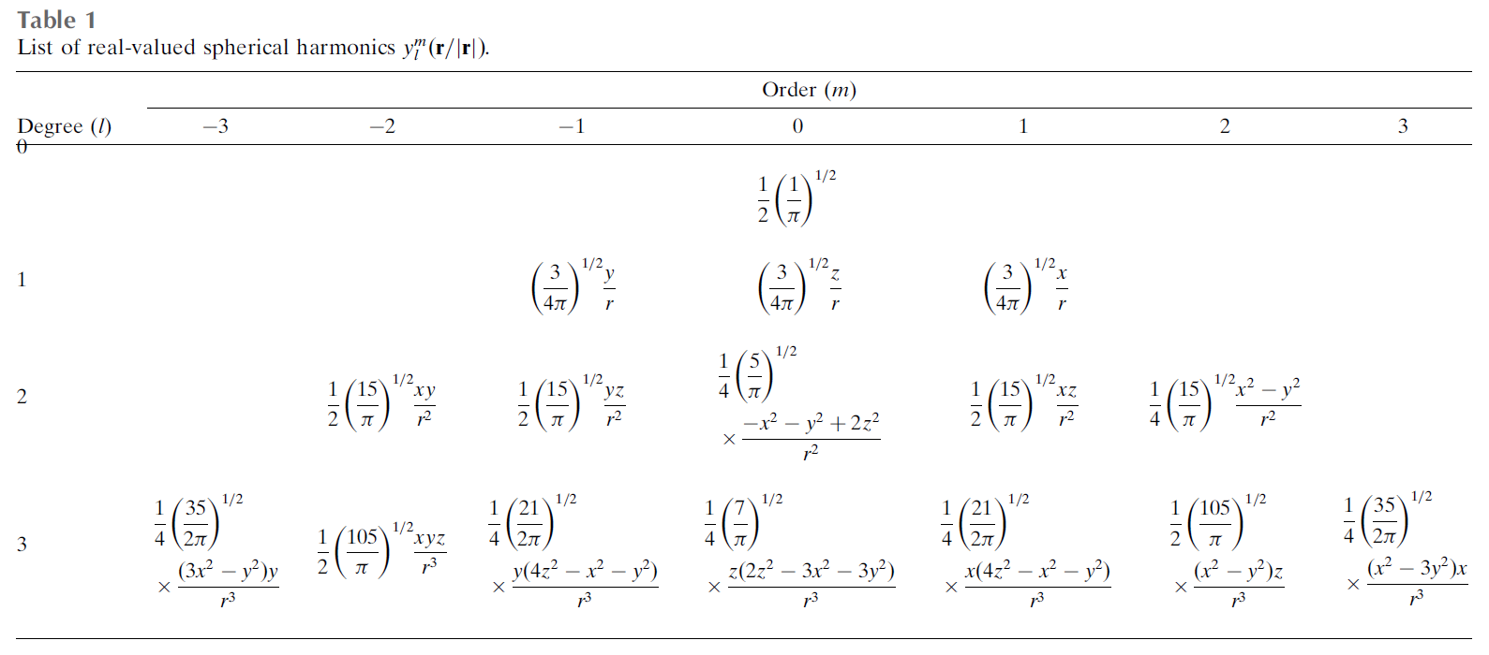



$$y_{l}^{m}\left(θ,φ\right)$$
$$Z_{l,n,m}\left(r\right)={\overline{R}}_{l,n}^{1}\left(r\right)y_{l}^{m}\left(θ,φ\right)$$
$$m$$
$$l$$

Slide 22





$$y_{l}^{m}\left(θ,φ\right)$$
$$Z_{l,n,m}\left(r\right)={\overline{R}}_{l,n}^{1}\left(r\right)y_{l}^{m}\left(θ,φ\right)$$
$$l$$
$$m$$

Slide 23


$${\overline{R}}_{l,n}^{1}\left(r\right)$$
$$Z_{l,n,m}\left(r\right)={\overline{R}}_{l,n}^{1}\left(r\right)y_{l}^{m}\left(θ,φ\right)$$
$$R_{l,n}^{p}\left(x\right)={\left(−1\right)}^{n}x^{l}P_{n}^{\left(l+\frac{p}{2}, 0\right)}\left(1+2x^{2}\right)$$
$$P_{n}^{\left(α, β\right)}=\frac{{\left(−1\right)}^{n}}{2^{n}n!}{\left(1−x\right)}^{−α}{\left(1+x\right)}^{−β}∙\frac{d}{dx^{n}}\left[{\left(1−x\right)}^{α}{\left(1+x\right)}^{β}{\left(1−x^{2}\right)}^{n}\right]$$
$${\overline{R}}_{l, n}^{p}\left(x\right)=2^{\frac{1}{2}}{\left[2n+l+\frac{p}{2}+1\right]}^{\frac{1}{2}}R_{l,n}^{p}\left(x\right)$$

Slide 24








$$Z_{l,n,m}\left(r\right)={\overline{R}}_{l,n}^{1}\left(r\right)×y_{l}^{m}\left(θ,φ\right)$$
$$r$$
0
1

Slide 25


$r$ : 3D coordinate ($r=\left(x,y,z\right)→\left(r,θ,φ\right)$)
$U_{1}\left(r\right)≅U_{2→1}\left(r\right)=U_{2}\left[r+g_{L}\left(r\right)\right]$
$$g_{L}\left(r\right)=\sum_{l=0}^{L}{\sum_{n=0}^{N}{\sum_{m=−l}^{l}{\left(\begin{matrix}α_{l,n,m}^{x} \\ α_{l,n,m}^{y} \\ α_{l,n,m}^{z}\end{matrix}\right)Z_{l,n,m}\left(r\right)}}}$$

Slide 26


Generalized Zernike polynomials
$U_{1}, U_{2}$: conformations of a given molecule
$U_{1}\left(r\right)≅U_{2→1}\left(r\right)=U_{2}\left[r+g_{L}\left(r\right)\right]$
$$g_{L}\left(r\right)=\sum_{l=0}^{L}{\sum_{n=0}^{N}{\sum_{m=−l}^{l}{\left(\begin{matrix}α_{l,n,m}^{x} \\ α_{l,n,m}^{y} \\ α_{l,n,m}^{z}\end{matrix}\right)Z_{l,n,m}\left(r\right)}}}$$
如何求取$g_{L}\left(r\right)$?
$$\min_{g_{L}}{\int{\left|U_{1}\left(r\right)−U_{2}\left[r+g_{L}\left(r\right)\right]\right|dr}}$$
如何求取$α_{l,n,m}$?
$$\min_{α_{l,n,m}}{\int{\left|U_{1}\left(r\right)−U_{2}\left[r+g_{L}\left(r\right)\right]\right|dr}+λ_{1}\int{{\left\|g_{L}\left(r\right)\right\|}^{2}dr}+λ_{2}}\frac{\left|\int{\left\{U_{1}\left(r\right)−U_{1}\left[r+g_{L}\left(r\right)\right]\right\}dr}\right|}{\int{U_{1}\left(r\right)dr}}$$
$$Z_{l,n,m}\left(r\right)={\overline{R}}_{l,n}^{1}\left(r\right)×y_{l}^{m}\left(θ,φ\right)$$

Slide 27





$$U_{ref}$$
$$Y_{i}=P_{i}U_{i}+ε_{i}$$
$${\hat{U}}_{i}\left(r\right)≅U_{ref}\left[r+g_{L}\left(r\right)\right]$$
$$\max_{g_{L}}{ρ\left(Y_{i},P_{i}{\hat{U}}_{i}\right)}$$
$$\max_{α_{l,n,m}}{ρ\left(Y_{i},P_{i}{\hat{U}}_{i}\right)}+λ_{1}\int{{\left\|g_{L}\left(r\right)\right\|}^{2}dr}$$
$$Y_{i}$$

Slide 28









補充: Rotation
$$r$$
$$r′$$
$$r^{′}=Ar$$
$A：$the appropriate unitary rotation matrix
$$U_{ref}\left[r+g_{L}\left(r\right)\right]$$
$$U_{ref}\left[r′+{\tilde{g}}_{L}\left(r′\right)\right]$$
$$g_{L}\left(r\right)=\sum_{l=0}^{L}{\sum_{n=0}^{N}{\sum_{m=−l}^{l}{\left(\begin{matrix}α_{l,n,m}^{x} \\ α_{l,n,m}^{y} \\ α_{l,n,m}^{z}\end{matrix}\right)Z_{l,n,m}\left(r\right)}}}$$
$${\tilde{g}}_{L}\left(r′\right)=\sum_{l=0}^{L}{\sum_{n=0}^{N}{\sum_{m=−l}^{l}{A\left(\begin{matrix}α_{l,n,m}^{x} \\ α_{l,n,m}^{y} \\ α_{l,n,m}^{z}\end{matrix}\right)Z_{l,n,m}\left(A^{−1}r′\right)}}}$$
$${\tilde{g}}_{L}\left(r′\right)=Ag_{L}\left(A^{−1}r′\right)$$

Slide 29

Generalized Zernike polynomials
$U_{1}, U_{2}$: conformations of a given molecule
$U_{1}\left(r\right)≅U_{2→1}\left(r\right)=U_{2}\left[r+g_{L}\left(r\right)\right]$
$$g_{L}\left(r\right)=\sum_{l=0}^{L}{\sum_{n=0}^{N}{\sum_{m=−l}^{l}{\left(\begin{matrix}α_{l,n,m}^{x} \\ α_{l,n,m}^{y} \\ α_{l,n,m}^{z}\end{matrix}\right)Z_{l,n,m}\left(r\right)}}}$$
如何求取$g_{L}\left(r\right)$?
$$\min_{g_{L}}{\int{\left|U_{1}\left(r\right)−U_{2}\left[r+g_{L}\left(r\right)\right]\right|dr}}$$
$$\min_{α_{l,n,m}}{\int{\left|U_{1}\left(r\right)−U_{2}\left[r+g_{L}\left(r\right)\right]\right|dr}+λ_{1}\int{{\left\|g_{L}\left(r\right)\right\|}^{2}dr}+λ_{2}}\frac{\left|\int{\left\{U_{1}\left(r\right)−U_{1}\left[r+g_{L}\left(r\right)\right]\right\}dr}\right|}{\int{U_{1}\left(r\right)dr}}$$
$$Z_{l,n,m}\left(r\right)={\overline{R}}_{l,n}^{1}\left(r\right)×y_{l}^{m}\left(θ,φ\right)$$

Slide 30
Q: PCA的系統 跟Zernike polynomials的系統 有什麼不一樣?

Slide 31

Distances between a set of maps
Generalized Zernike polynomials ($g_{L}\left(r\right)$: has Zernike polynomials basis)
$$U_{i}\left(r\right)≅U_{j→i}\left(r\right)=U_{j}\left[r+g_{L}\left(r\right)\right]$$
方法一
$$d_{1}\left(U_{i}, U_{j}\right)=\int{{\left\|g_{L}\left(r\right)\right\|}^{2}dr}$$
方法二 (correlation)
$$d_{2}\left(U_{i}, U_{j}\right)=1−ρ\left\{U_{j}\left[r+g_{L}\left(r\right)\right],U_{i}\left(r\right)\right\}$$

Slide 32



MDS Results (1)
$$d_{1}\left(U_{1}, U_{2}\right)=\int{{\left\|g_{L}\left(r\right)\right\|}^{2}dr}$$
$$d_{2}\left(U_{1}, U_{2}\right)=1−ρ\left\{U_{2}\left[r+g_{L}\left(r\right)\right],U_{1}\left(r\right)\right\}$$

Slide 33


MDS Results (2)
$$d_{1}\left(U_{1}, U_{2}\right)=\int{{\left\|g_{L}\left(r\right)\right\|}^{2}dr}$$
$$d_{2}\left(U_{1}, U_{2}\right)=1−ρ\left\{U_{2}\left[r+g_{L}\left(r\right)\right],U_{1}\left(r\right)\right\}$$

Slide 34

Q: 是否可以嘗試取得$d_{1}$與$d_{2}$所做出的 MDS consensus mapping

Slide 35




The consensus mapping (1)
consensus mapping
$$d_{1}$$
$$d_{2}$$

Slide 36

The consensus mapping (2)
consensus mapping
$$d_{1}$$
$$d_{2}$$

Slide 37

The consensus mapping
用$d_{1}$做出的MDS為$X_{1}$，用$d_{2}$做出的MDS為$X_{2}$ ($N×p$)
如何整合$X_{1}$與$X_{2}$?
We take one of the mappings as reference (for instance, $X_{1}$)
We look for the affine transformation $T_{i}$ ($T_{1}\left(X_{1}\right)=X_{1}$)
$$\min_{T_{i}}{{\left\|X_{1}−T_{i}\left(X_{i}\right)\right\|}_{F}}$$
The consensus mapping
$$X_{α}=\sum_{i}{α_{i}T_{i}\left(X_{i}\right)}$$
$α$的求法:
$$\underset{α}{argmin}\left\{−\int{p_{α}\left(x\right)\log\left[p_{α}\left(x\right)\right]dx}\right\}，p_{α}\left(x\right)=\sum_{j}{\frac{1}{N}}G_{σ}\left(x−x_{j,α}\right)$$

Slide 38
Major contributions
The development of an automatic algorithm to analyses continuous heterogeneity of macromolecules through cryo-EM maps.
Representation of the strain and rotation components defining a transition between two different conformational states.
Representation of a series of conformations in a structure mapping and consensus of different mappings defined by different comparison metrics.
A methodology to compare cryo-EM maps with simulated data.
The application of deformation fields to atomic structures to predict different conformations given by a series of cryo-EM maps.

Slide 39
The End

